Slide 1
CHAPTER 3
DIFFERENTIATION RULES

Slide 2
CONTENTS
3.1. Derivatives
3.2. Derivative as a Function
3.3. Differentiation Formulae
3.4. Rates of Change in the Natural and Social Sciences
3.5. Derivatives of Trigonometric Functions
3.6. The Chain Rule
3.7. Implicit Differentiation
3.8. Derivatives of Logarithmic Functions
3.9. Related Rates
3.10. Linear Approximations and Differentials

Slide 3
3.3. DIFFERENTIATION FORMULAE
3.3.1. Derivatives of Power Functions
3.3.2. New Derivatives from Old
3.3.3. Derivatives of Exponential Functions
3.3.4. The Product and the Quotient Rules

Slide 4
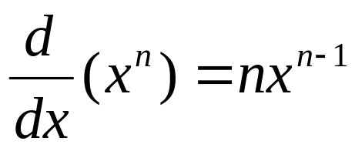
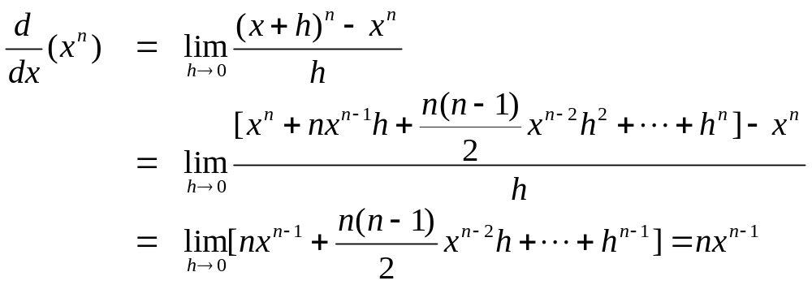
3.3.1 Derivatives of Power Functions
The Power Rule. If n is a positive integer then
Proof.

Slide 5
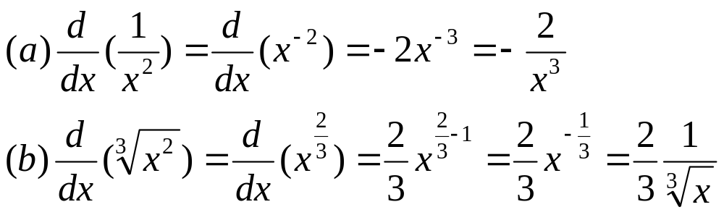
The Power Rule (General Version). If n is any real number then
Example.

Slide 6
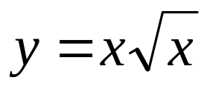
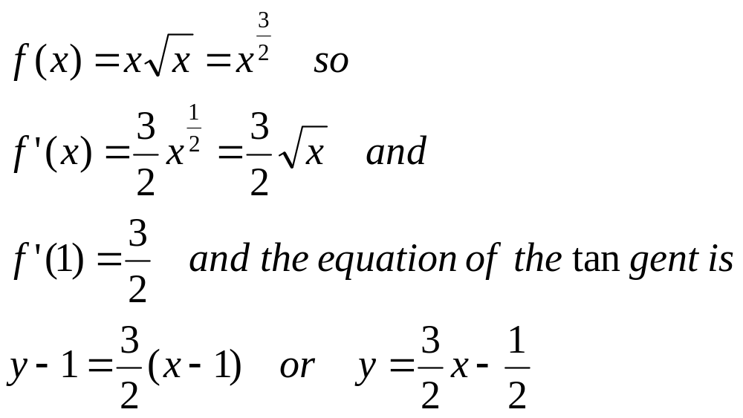
Example. Find the equation of the tangent to the curve at the point (1, 1) and graph the curve and the tangent
Solution.

Slide 7
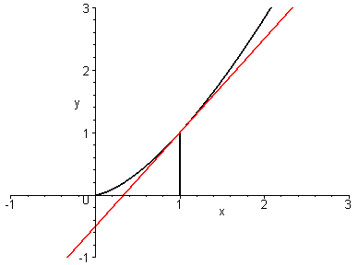
We can graph the curve and its tangent using MAPLE command showtangent
> with(student):
> showtangent(x*sqrt(x),x=1);

Slide 8
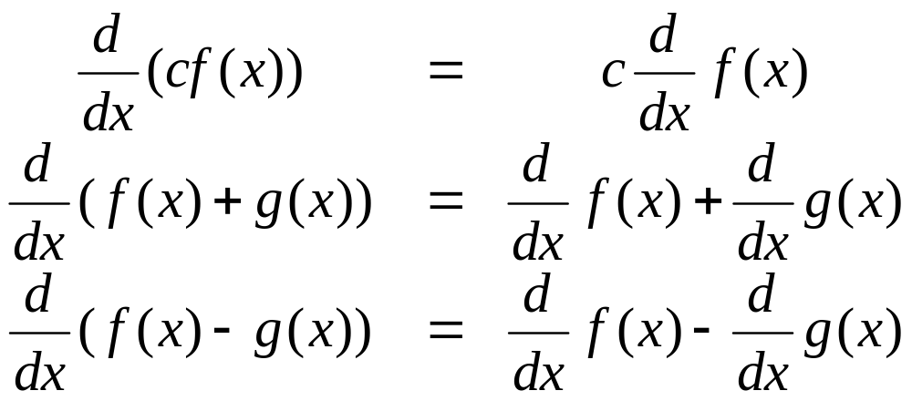
3.3.2 New Derivatives from Old
Theorem. If f and g are differentiable and c is a constant, then we have

Slide 9
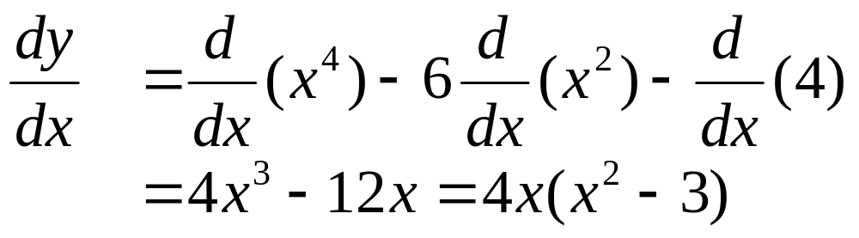
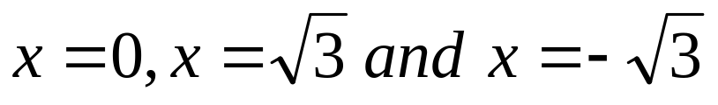
Example. find the points on the curve y=x⁴ - 6x² + 4 where the tangents are horizontal
Solution. the tangents are horizontal at the zeros of the derivatives
Therefore the tangents are horizontal at the points

Slide 10
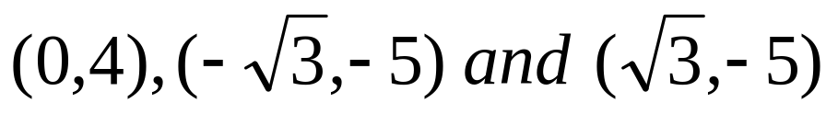
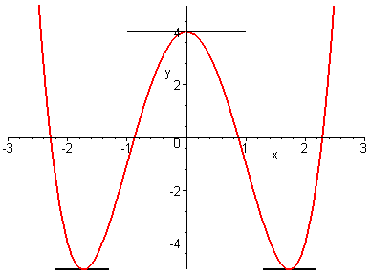
The graph of the curve y=x⁴ - 6x² + 4 and the horizontal
tangents at

Slide 11
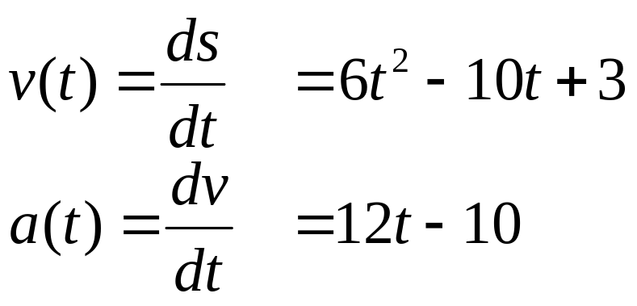
Example. The equation of motion of particle is s = 2t³ – 5t² + 3t + 4 . Find the acceleration after 2 seconds
Solution. the velocity and acceleration are given by
Hence the acceleration of the particle after 2 seconds is a(2) = 24 – 10 = 14 cm/s²

Slide 12
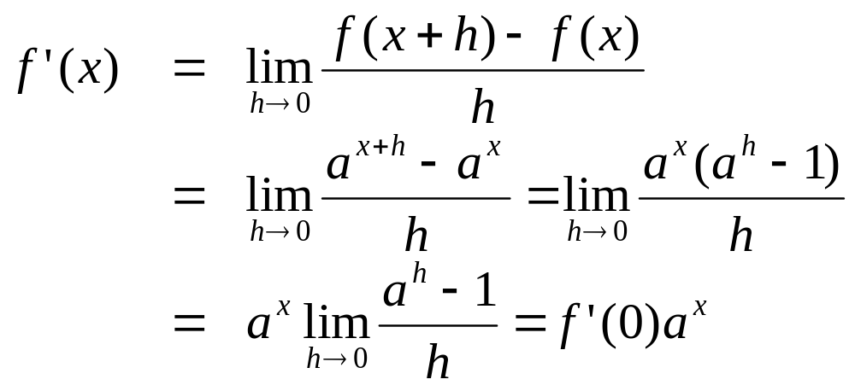
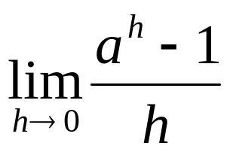
3.3.3 Derivatives of Exponential Functions
Let f(x) = a^{x} , then
Here we admit that for any positive real number a,
exists

Slide 13
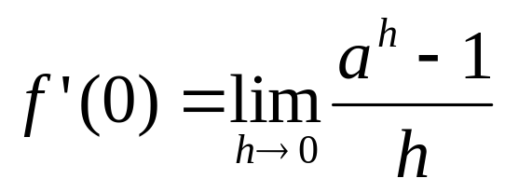
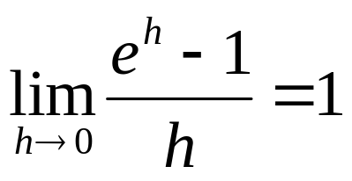
It follows that the slope of the tangent of the curve
y=a^{x} at x = 0 is
Recall that the number e is defined so that the slope of the tangent of the curve y=e^{x} at x = 0 is 1. Hence
Definition of the number e.
e is the number such that

Slide 14
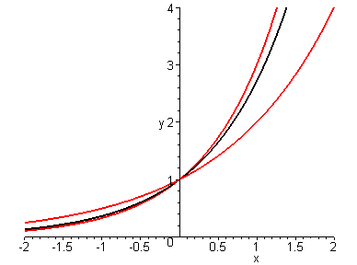
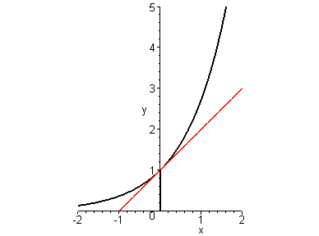

Slide 15
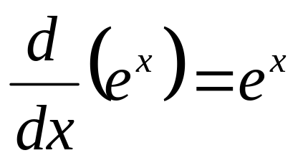
Derivative of the Natural Exponential Function.

Slide 16
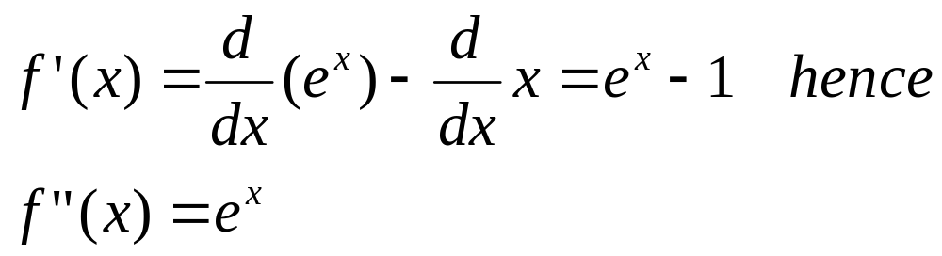
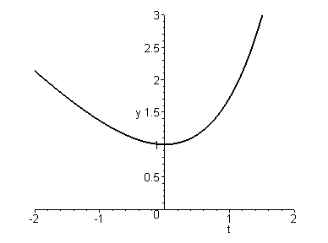
Example. If f(x) = e^{x} – x find f’ and f”
Solution.

Slide 17
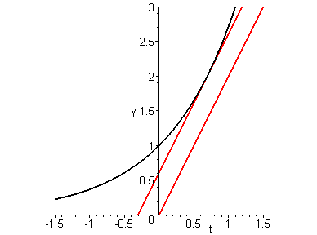
Example. At what point, the tangent to the curve y = e^{x} is parallel to the line y = 2x
Solution. the slope of the tangent at the point with x-coordinate equals to a is f’(a)=e^{a.}
Hence we must have
eª = 2, i.e. a = ln 2
Therefore the corresponding point is (ln 2, 2)

Slide 18
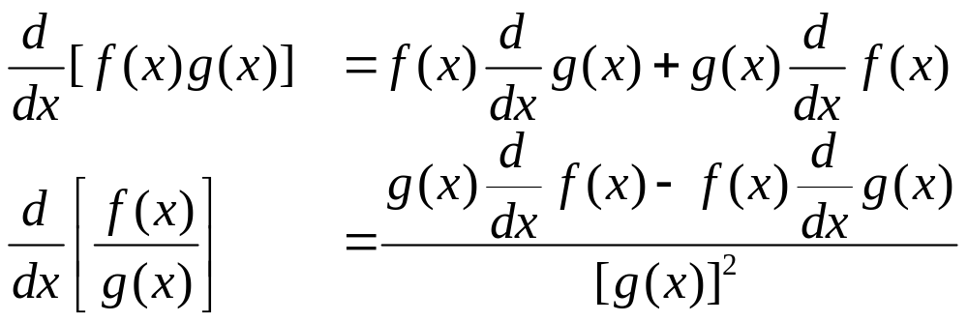
3.3.4. THE PRODUCT and THE QUOTIENT RULES
Theorem . If f and g are differentiable, then

Slide 19
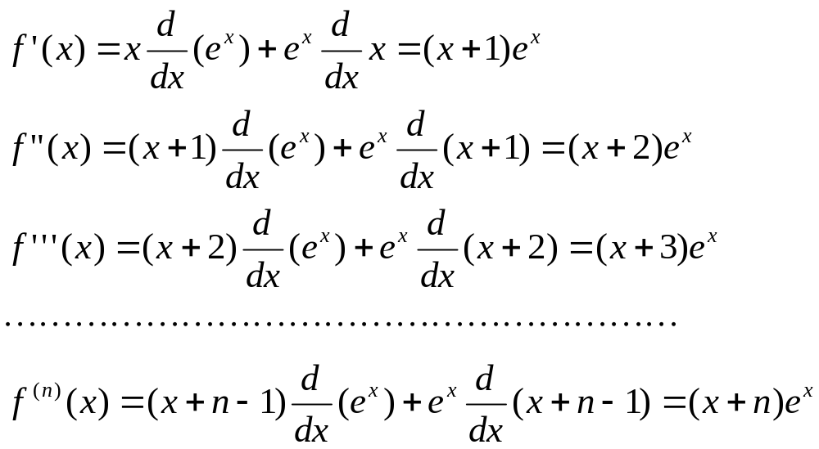
Example. If f(x) =x e^{x} , find f’(x), f”(x),…, f ^{(n)}(x)
Solution.

Slide 20
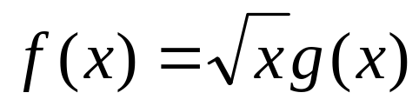
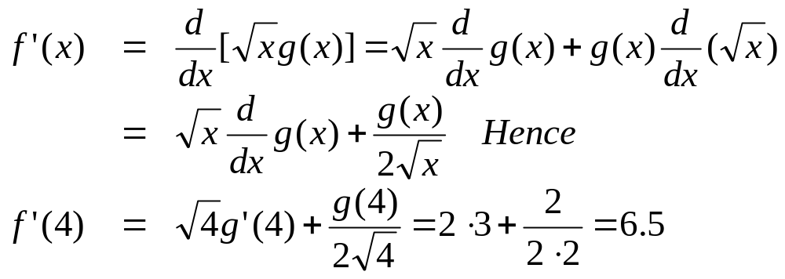
Example. If
where g(4)=2 and g’(4)=3, find f’(4)
Solution.

Slide 21
Example. Telephone subscribers at Jan 1 is 100,000, each has 1.2 lines. The subscribership increased at the rate of 1,000 per month.
Each subscriber intended to install 0.01 more lines by Jan 31. How many new lines the company will have to install in Jan ?
Solution. Let s(t) be the number of subscribers and n(t) be the number of lines per subscriber at time t. Then the total the number of lines is
L(t) = s(t)n(t)
We have
L’(0) = s(0) n’(0) + s’(0) n(0)
≈ 100,000⋅ 0.01 + 1000 ⋅ 1.2 = 2,200

Slide 22
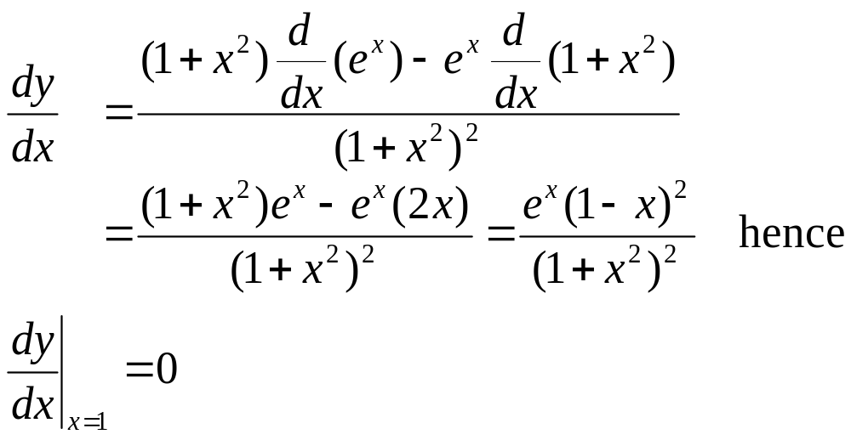
Example. Find an equation of the tangent to the curve y = e^{x} /(1 + x ²) at the point (1, e/2)
Solution. We have

Slide 23
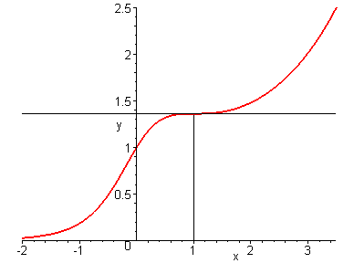
y=e/2 is the horizontal tangent at (1, e/2)

Slide 24
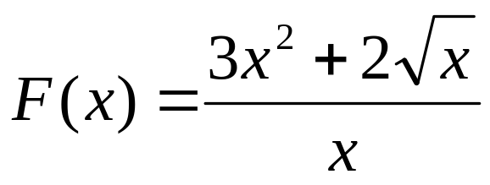
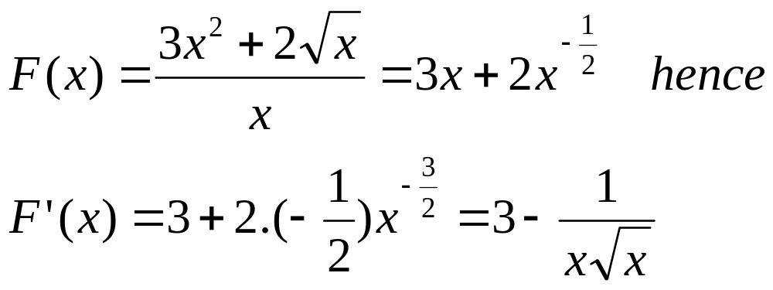
Remark. Before deciding to apply the Quotient Rule, it is better to simplify the quotient
Example. Differentiate
Solution. We have

